Slide 1

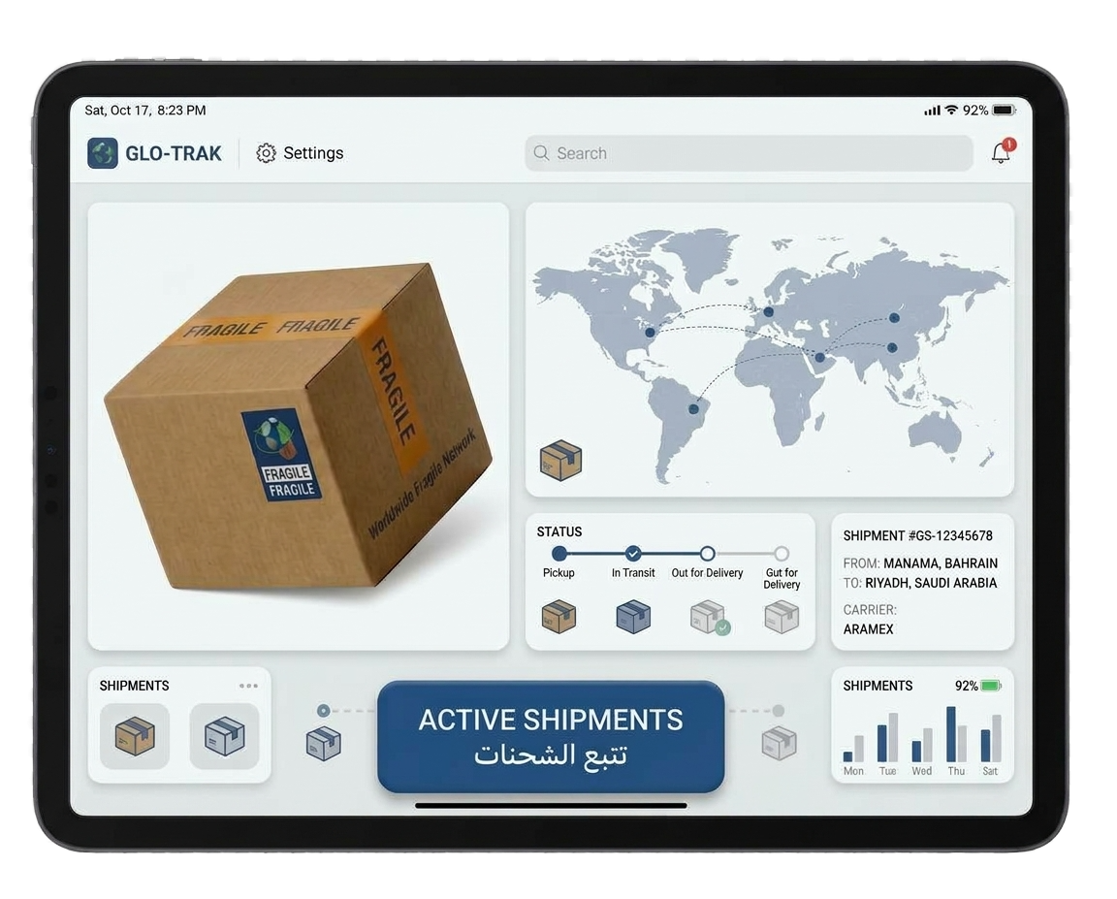
Olist
Delivery Model
Nebras Jafail – DSB3
Fatema Shaker – DSB3
Fatema Butaher – DSB3
Noora Alkhalaqi – DSB3

Slide 2
Agenda
Models MAE Comparison
Business Section
The raw issue
The structured objectives
Technical Section
Correlation with the target
Data Processing Overview
Models MAE Comparison
Demo Section
Live demo: the customer journey
Confirm Order Cancellation
Incorrect / Changed Address
Changed Mind
Delivery Delay
High Shipping Fees
Accidental Order
Confirm
Back

Slide 3

The raw issue
Confirm Order Cancellation
Customers abandon carts when they cannot see when an order will arrive. Typical delivery takes 10 days, but 1 in 10 orders takes over 3 weeks.
Incorrect / Changed Address
Changed Mind
Delivery Delay
High Shipping Fees
Accidental Order
Confirm
Back
Problem type: Regression

Slide 4
36%
Where customer and seller shares a state
The structured objectives
Specific: predict delivery time in days for every order at checkout, from seller and customer location, distance, product size and weight, freight cost and order timing.
Business objective: show a trusted delivery date before Order Now, to cut order cancellation by 12% and increase sales by gaining customers satisfaction.
Measurable: average estimate within 5 days of the actual delivery (our model: 4.6 days on unseen orders).
0.39
Correlation between distance (km) and Delivery days
~0.60
Correlation between the freight value and the product weight / volume

Slide 5
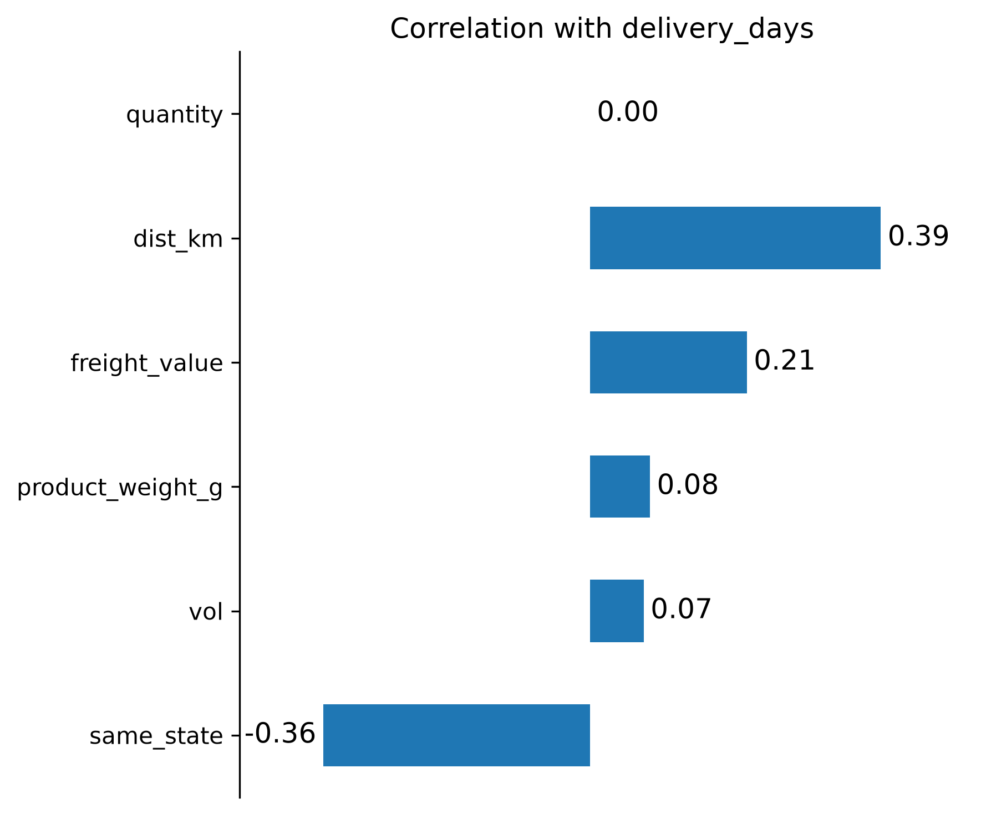
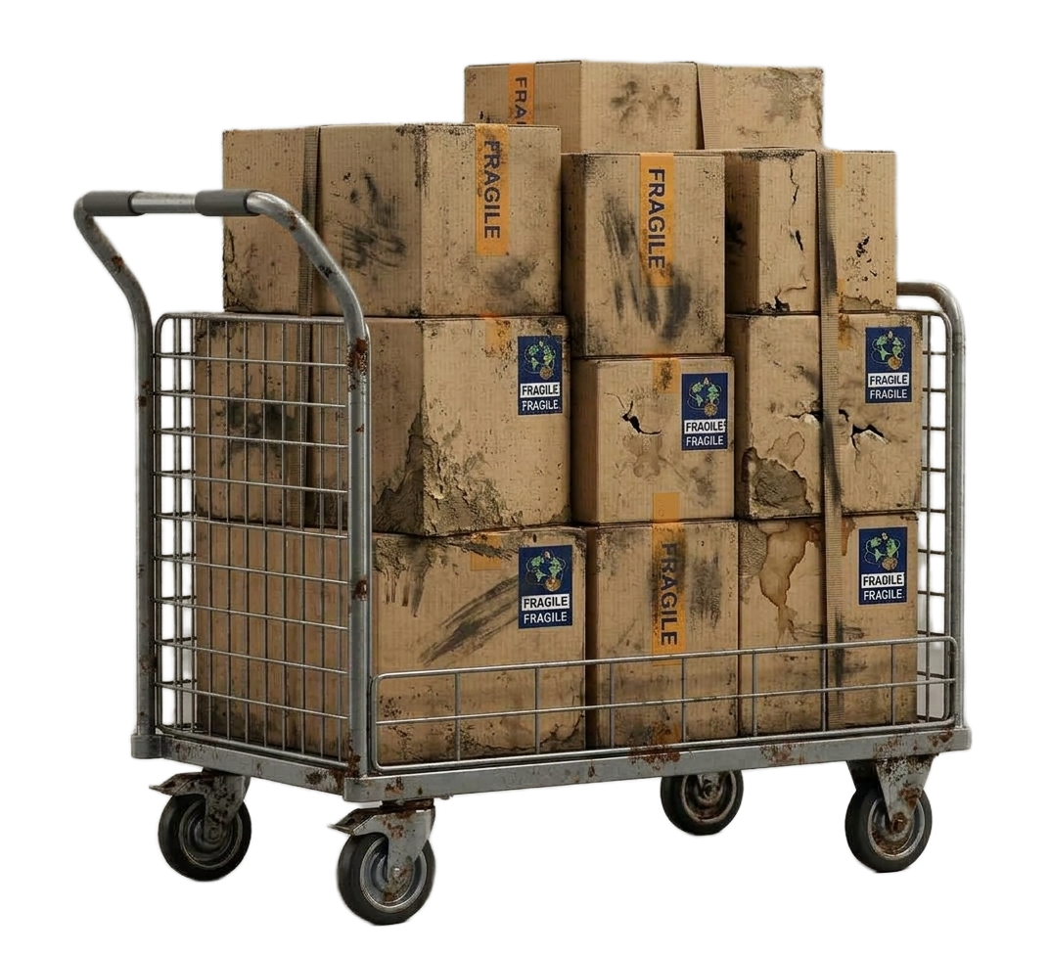
Data Processing
Overview
36%
Where customer and seller shares a state
0.39
Correlation between distance (km) and Delivery days
0.59 – 0.61
Correlation between the freight value and the product weight / volume

Slide 6
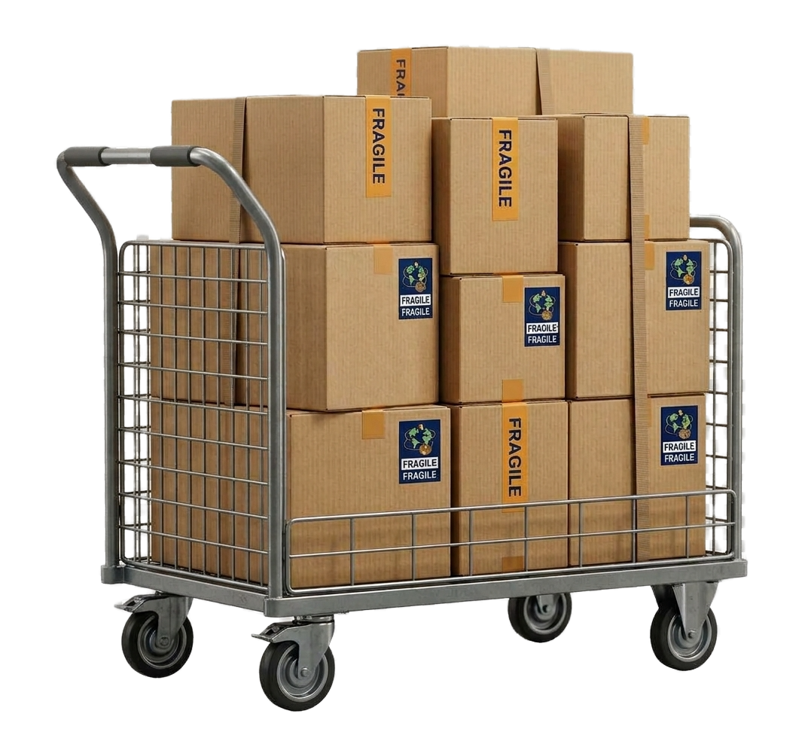
Data Processing
Data
Overview
7 Olist files combined into one table: one row per ordered item
Seller-to-customer distance calculated from zip codes averaged coordinates
Final dataset: 98,767 delivered orders
Cleaning
Removed contradictory orders ( “delivered” with no delivery date , “canceled” with a delivery date.)
Removed items with no product category
Merged repeat purchases of the same item into one row with a quantity
Kept delivered orders only 98,797, since we need a real delivery time to learn from
We replaced seller IDs with simple labels (seller 1, seller 2, etc.)

Slide 7
Data Processing
New features
Overview
Distance(km), same-state flag, product volume, purchase month, weekday and hour
Missing information
Rows missing key fields were dropped
Smaller gaps (weight, size, location) were filled automatically, using the 'median’ value for numbers and “missing” for categories
Metric: Mean Absolute Error
The average number of days our estimate is off. Easy to read, and it matches how customers judge a late or early delivery.

Slide 8
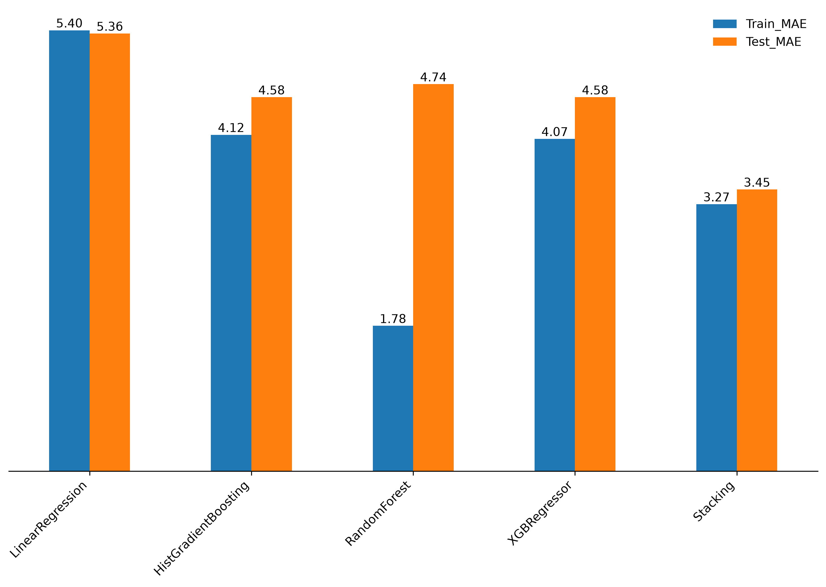
Models MAE Comparison

Slide 9

Live demo: the customer journey
Customer Adress
Selecting Category
Checkout
View Sellers
State
Zip code
Product category
Quantity
Sellers
Prices
Estimated Delivery
Order details
Confirmation
Streamlit

Slide 10
Thank
You

